Slide 1

Database Management System (CS232) BS(SE) gg
Week 02
Said Nabi
said.nabi@giki.edu.pk
Faculty of Computer Science and engineering
Gik Institute Topi, Swabi

Slide 2
Topics
DBMS Architectures
Data Independence – Levels of Abstraction
Design life cycles of databases
Data Modeling and data models
SQL Language Categories

Slide 3
DBMS Architectures
Centralized DBMS Architecture:
Combines everything into single computer system, including: DBMS software, hardware, application programs, and user interface processing software.
User can still connect through a remote terminal – however, all processing is done at centralized site (computer).

Slide 4
DBMS Architectures (cont.)
Basic 2-tier Client-Server Architecture: Specialized Server nodes with Specialized functions
Print server
File server
DBMS server
Web server
Email server
Client nodes can access the specialized servers as needed

Slide 5
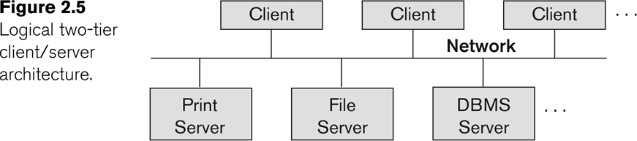
Logical two-tier client server architecture

Slide 6
Client nodes
Provide appropriate interfaces through a client software module to access and utilize the various server resources.
Clients may be PCs or Workstations (or even diskless machines) with the client software installed.
Connected to the servers via a network.
LAN: local area network
wireless network
etc.

Slide 7
Three Tier Client-Server DBMS Architecture
Common for Web applications
Third intermediate layer (middle tier) called Application Server or Web Server:
Stores the web connectivity software and the business logic part of the application
Accesses and updates data on the database server
Acts like a conduit for sending partially processed data between the database server and the client.
Three-tier Architecture Can Enhance Security:
Database server only accessible via middle tier
Clients cannot directly access database server

Slide 8
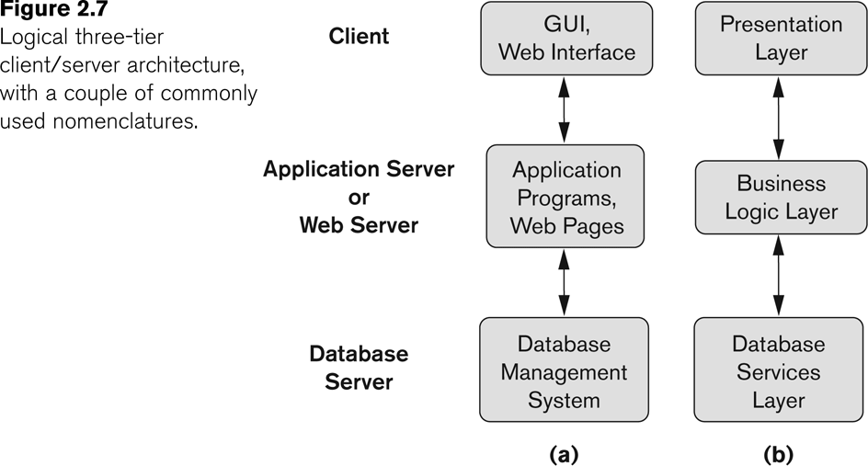
Three-tier client-server architecture

Slide 9
ANSI/SPARC three-Level Architecture (cont.)
Defines DBMS schemas at three levels:
External schemas at the external level to describe the various user views.
Usually uses the same data model as the conceptual schema.
Conceptual schema at the conceptual level to describe the structure and constraints for the whole database for a community of users. Uses an implementation (or a conceptual) data model.
Internal schema at the internal level to describe physical storage structures and access paths (e.g indexes).
Typically uses a physical data model.

Slide 10
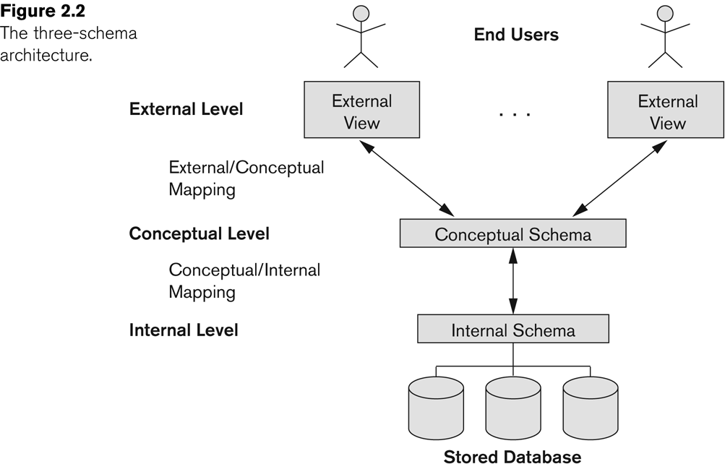
ANSI/SPARC three-Level Architecture (cont.)

Slide 11
ANSI/SPARC three-Level Architecture (cont.)
Mappings among schema levels are needed to transform requests and data.
Users and programs refer to an external schema, and are mapped by the DBMS to the internal schema for execution.
Data extracted from the internal DBMS level is reformatted to match the user’s external view (e.g. formatting the results of an SQL query for display as a Web page)

Slide 12
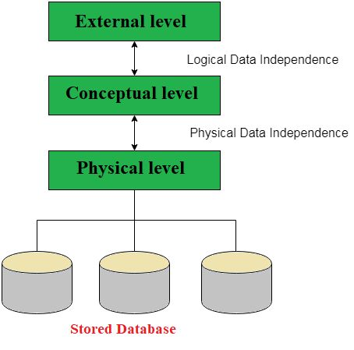
Levels of Data Independence

Slide 13
Data Independence (cont.)
Logical Data Independence:
The capacity to change the conceptual schema without having to change the external schemas and their associated application programs.
Physical Data Independence:
The capacity to change the internal schema without having to change the conceptual schema.
For example, the internal schema may be changed when certain file structures are reorganized or new indexes are created to improve database performance

Slide 14
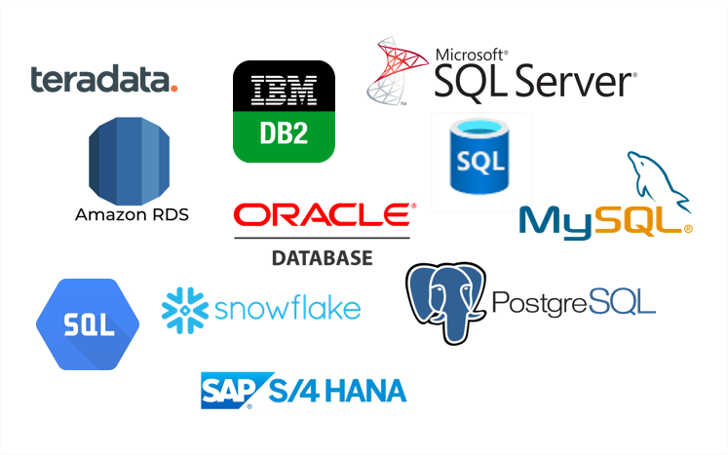
Examples RDBMS
14

Slide 15
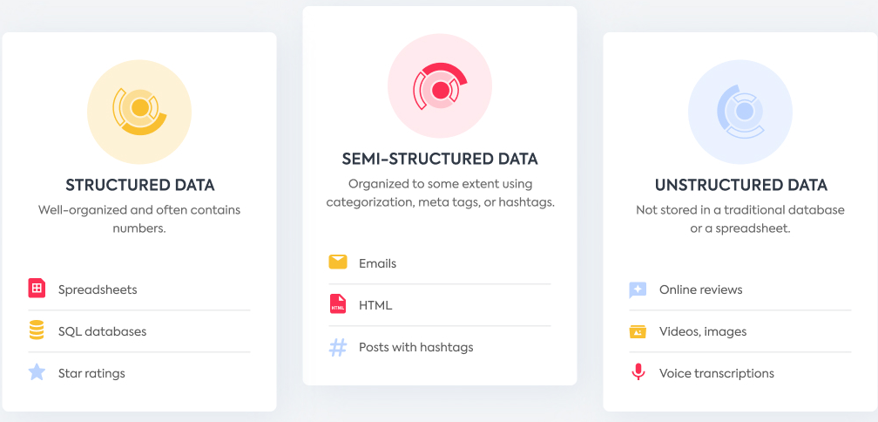
Types of Data
Types
Structured Data
Unstructured Data

Slide 16
Structured Data
Stored in tabular format
Clearly defined
Data is stored in a pre-defined data model
Think of data that fits neatly within fixed fields and columns in relational databases and spreadsheets.
Examples of structured data include
names, dates, addresses,
credit card numbers,
stock information,
geolocation, and more.

Slide 17
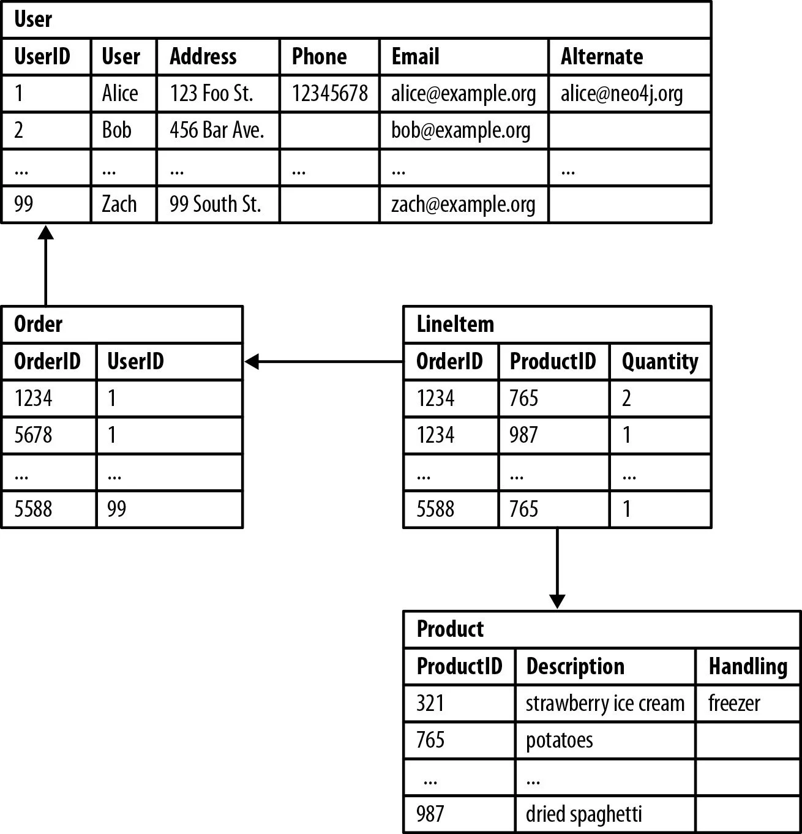
Structured Data
RDBMS
Structured data is stored in relational databases

Slide 18




Unstructured Data
No predefined structure
No data model
Irregular and ambiguous
Examples of unstructured data include
text,
video files,
audio files,
mobile activity,
social media posts,
satellite imagery,
surveillance imagery
Non-relational or NoSQL databases are the best fit for managing unstructured data.
Notes:
Post title
Description
Unstructured data is harder to analyze and process than structured data, which is why it often goes unused.
But cloud computing and AI tools equipped with machine learning are introducing new ways to manage this data, which contains a myriad of valuable customer insights.

Slide 19

ACID Property
Atomicity - a transaction to transfer funds from one account to another involves making a withdrawal operation from the first account and a deposit operation on the second. If the deposit operation failed, you don’t want the withdrawal operation to happen either.

Slide 20
Cont..
Consistency: This property ensures that the transaction maintains data integrity constraints, leaving the data consistent. The transaction creates a new valid state of the data and if some failure happens, return all the data with the state before the transaction being executed.
Notes:
Another example, if you have a column that does not allow negative numbers, and try to add or modify a record, using a value lower than zero on this column, the transaction will fail.

Slide 21
Cont..
Isolation: This property ensures the isolation of each transaction, ensuring that the transaction will not be changed by any other concurrent transaction. It means that each transaction in progress will not be interfered by any other transaction until it is completed.
Notes:
For example, if two clients are trying to buy at the same time the last available product on the web site, when the first user finishes the shopping, it will make the transaction of the other user be interrupted.

Slide 22
Cont..
Durability: Once a transaction is completed and committed, its changes are persisted permanently in the database. This property ensures that the information that is saved in the database is immutable until another update or deletion transaction affects it.
Notes:
Once a transaction is completed and committed, its changes are persisted permanently in the database. This property ensures that the information that is saved in the database is immutable until another update or deletion transaction affects it.

Slide 23
A Motivating Scenario
Pakistan Foundation (PF) has a “large” collection of data (say 500GB) on employees, students, universities, research centers, etc.,
This data is accessed concurrently by several people
Queries on data must be answered quickly
Changes made to the data by different users must be applied consistently
Access to certain parts of data (e.g., salaries) must be restricted
This data should survive system crashes/failures
Performance (Concurrency Control)
Performance (Response Time)
Correctness (Consistency)
Correctness (Security)
Correctness (Durability and Atomicity)

Slide 24
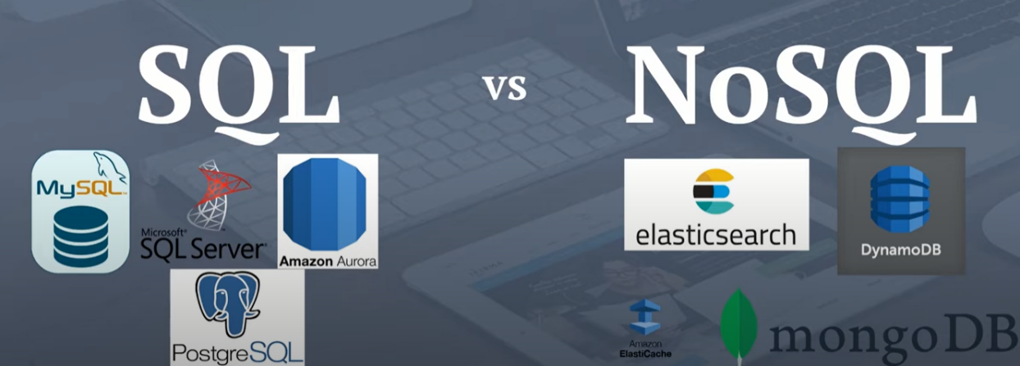
Types of Databases
SQL DB are structured DBs (DBMS)
NoSQL database is
a next-generation DB
used for big data, mainly retrieval purpose
horizontally scalable
Apache Cassandra, Apatchi HBase, Google Bigtable and MongoDB
Graph, Document, Key-value and Column Database are also known as NoSQL
Cloud DBs MS Azure & Amazon AWS
Notes:
The scalability of an application can be measured by the number of requests it can effectively support simultaneously.
Horizontal scaling means scaling by adding more machines to your pool of resources (also described as “scaling out”), whereas vertical scaling refers to scaling by adding more power (e.g. CPU, RAM) to an existing machine (also described as “scaling up”).

Slide 25
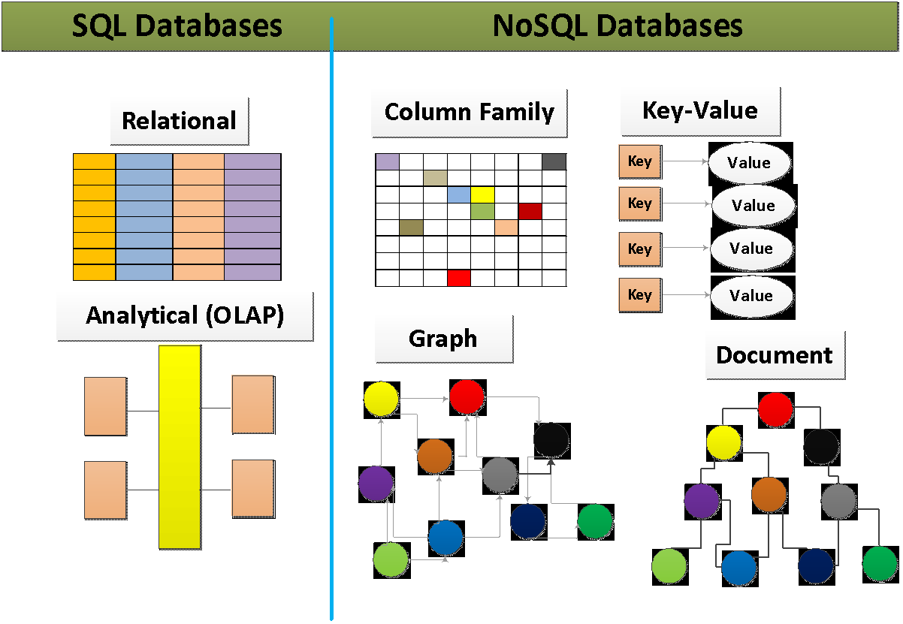
Architectures

Slide 26
SQL
It has a predefined schema.
Add Nil if data is not present (Memory Wastage)
Change Schema or Data in case of modifications
Tabular format
Not easily scalable (designed for 90’s technology or worse)
Requires joins

Slide 27
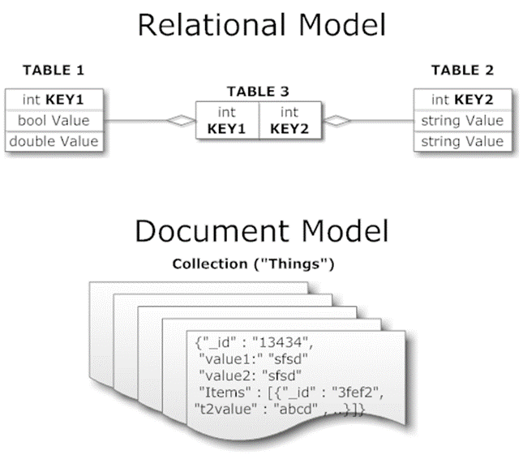
NoSQL
Schema-less Database: It is a schema-less database.
Change can be easily incorporated
Key/value (Dynamo)
Columnar/tabular (HBase)
Document (mongoDB)

Slide 28
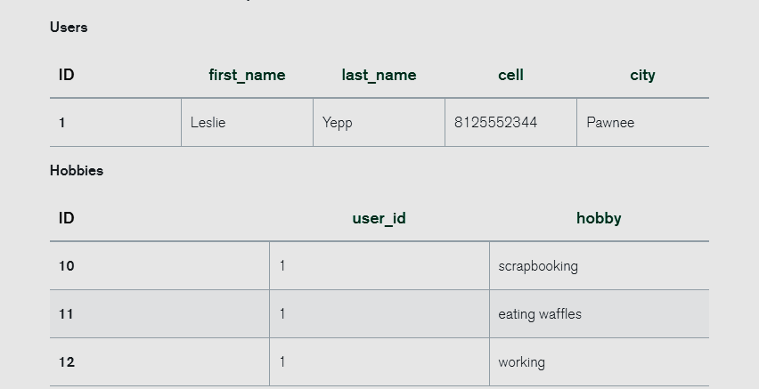
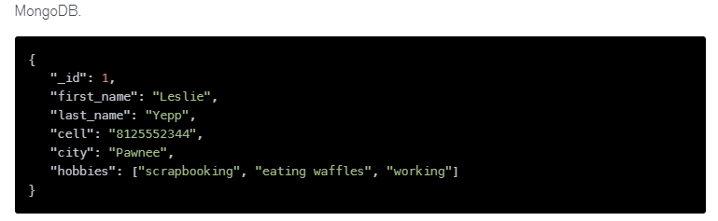
SQL vs NoSQL

Slide 29
Is NoSQL better than SQL?
NoSQL tends to be a better option for modern applications that have more complex, constantly changing data sets, requiring a flexible data model that doesn’t need to be immediately defined.
NoSQL databases can store and process data in real-time.
NoSQL databases can't typically enforce or guarantee uniqueness for keys within documents like traditional relational systems do.

Slide 30



Factors while selecting Database Management System
Choosing a database management system that is right for your business can be challenging.
It's essential to consider what you want from the system and how much effort you will put into managing it.
If you need flexibility in information storage without code changes or additional IT infrastructure, NoSQL may work for you.
Queries and security features are critical components of your solution, traditional SQL systems will likely provide better performance with more mature toolsets available
Notes:
https://wonderfulengineering.com/5-things-to-consider-when-choosing-a-database-management-system/

Slide 31
Data Models
WHAT IS MODEL?
A representation of real world objects, events and their association is called a model”
Benefit: It helps in understanding the complexities of real-world environments.
WHAT IS DATAMODEL?
A collection of concepts to describe and manipulate data, relationship b/w data and constraints on the data”
Benefit: It helps in understanding the complexities of data and finding relevant information from it.

Slide 32
Parts of Data Models
STRUCTURAL PART :
It consists of set of rules, that specify how database can be developed.
MANIPULATIVE PART
It defines the types of operations that can be performed on data, It includes the operations like updating/retrieving data or changing database structure.
INTEGRITY RULES PART
It includes the rules that ensure the accuracy in the database.

Slide 33
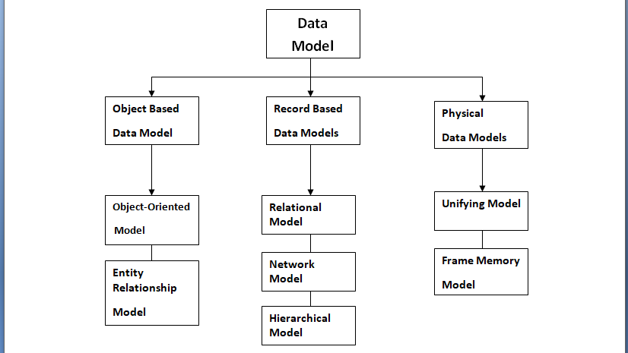
Types of Data Models

Slide 34
Types of Data Models
OBJECT DATA MODEL
“Object based data models use concepts like entities, attributes and relationships”
1. Entity: Person/Place/Thing/Event for which data is collected.
2. Relationship: An association between two or more entities.
3. Attributes: Characteristics or properties of one or more entities.
RECORD DATA MODEL
Record based data models are consist of fixed-format records of difference record types. Each record type define fix number of fields, each field is of fix length.”
PHYSICAL DATA MODEL
“This model represents the store procedures such as record structures, record ordering & access paths.”

Slide 35
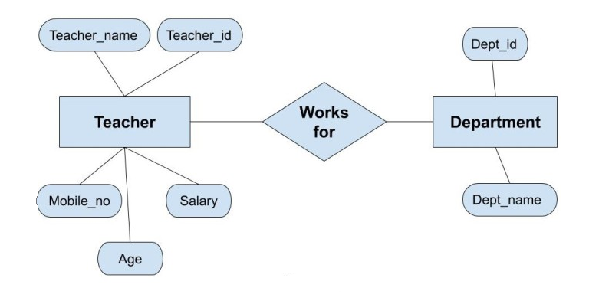
Types of Data Models
OBJECT BASED DATA MODELS
ENTITY RELATIONSHIP MODEL
“This model is a real world graphical approach to database design. It is a high-level model that defines data elements and their relationship for a specified software system.”

Slide 36
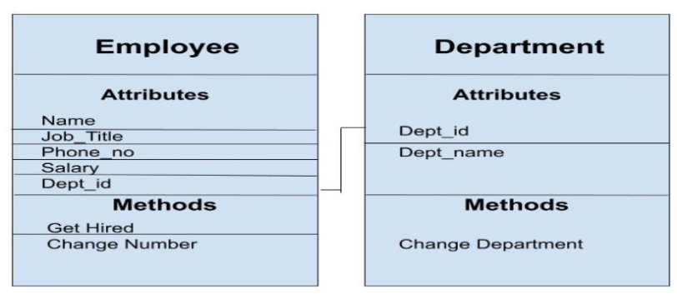
Types of Data Models
OBJECT BASED DATA MODELS
SEMANTIC OBJECT MODEL
“Sematic object model is logical representation of data in an organization. It views the entire system as collection of objects related to one & another. These objects are grouped into the classes and instances.”

Slide 37
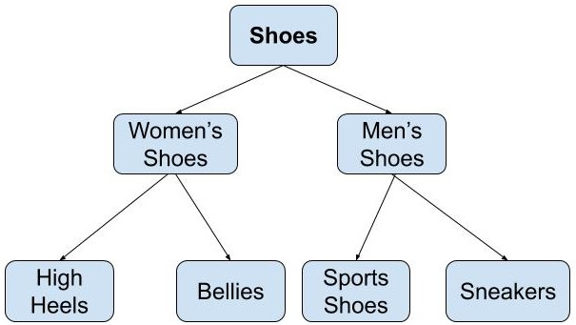
Types of Data Models
RECORD BASED DATA MODELS
1
HIRERCHICAL MODEL
“In hierarchical data model, data is connected by parent child relationship which is organized into a tree-like structure. Related data records are connected through nodes and pointers.”

Slide 38
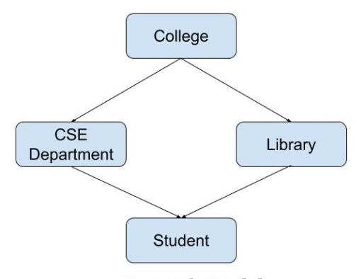
Types of Data Models
RECORD BASED DATA MODELS
NETWORK MODEL
“This model was created to resolve short comings of hierarchical model by allowing multiple parent child relationships, in this model a child can be linked with more than one parents.”
2

Slide 39
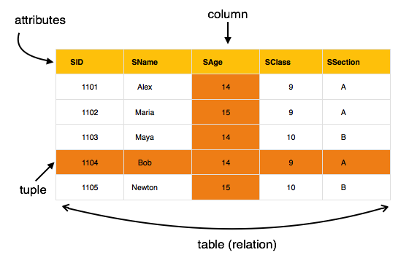
Types of Data Models
RECORD BASED DATA MODELS
RELATIONAL MODELS
“In relational models data is stored in relations/tables. Each table in database has unique name that identify its concepts, table/relation is also called intersection of rows and columns.”
3

Slide 40
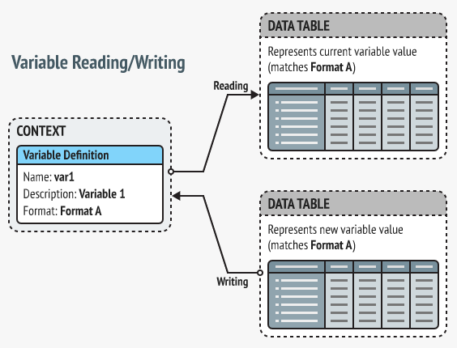
Types of Data Models
PHYSICAL DATA MODELS
1
UNIFYING MODEL
“Unified data model acts as a bridge between two different data models /ecosystems. It builds foundation for collection & correlation of data from multiple sources.”

Slide 41
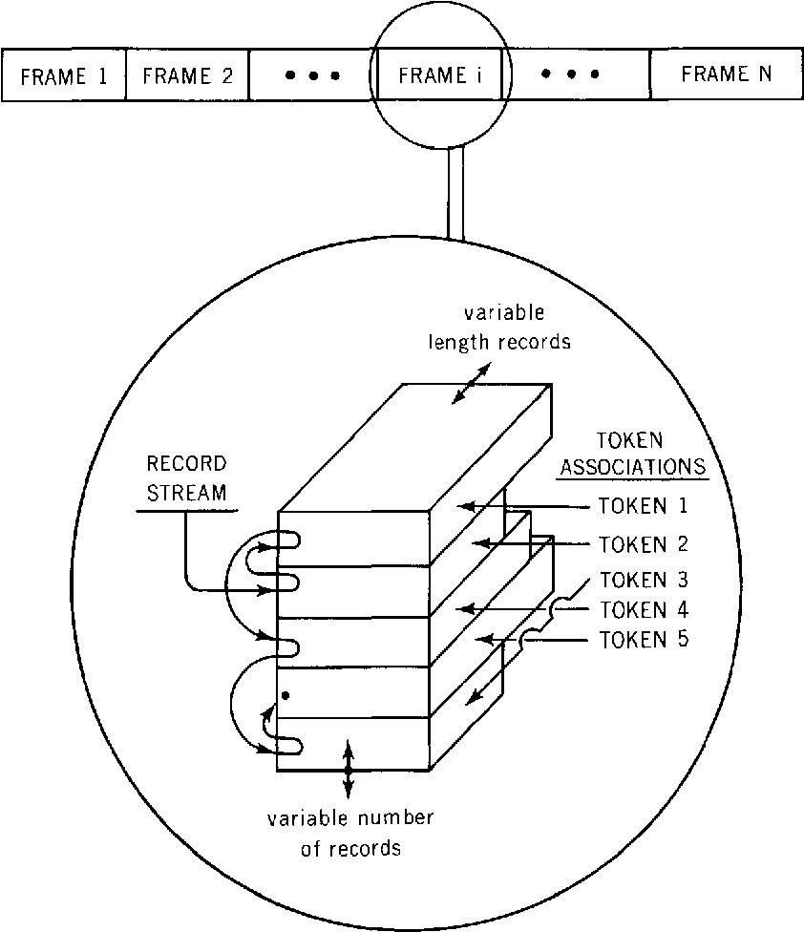
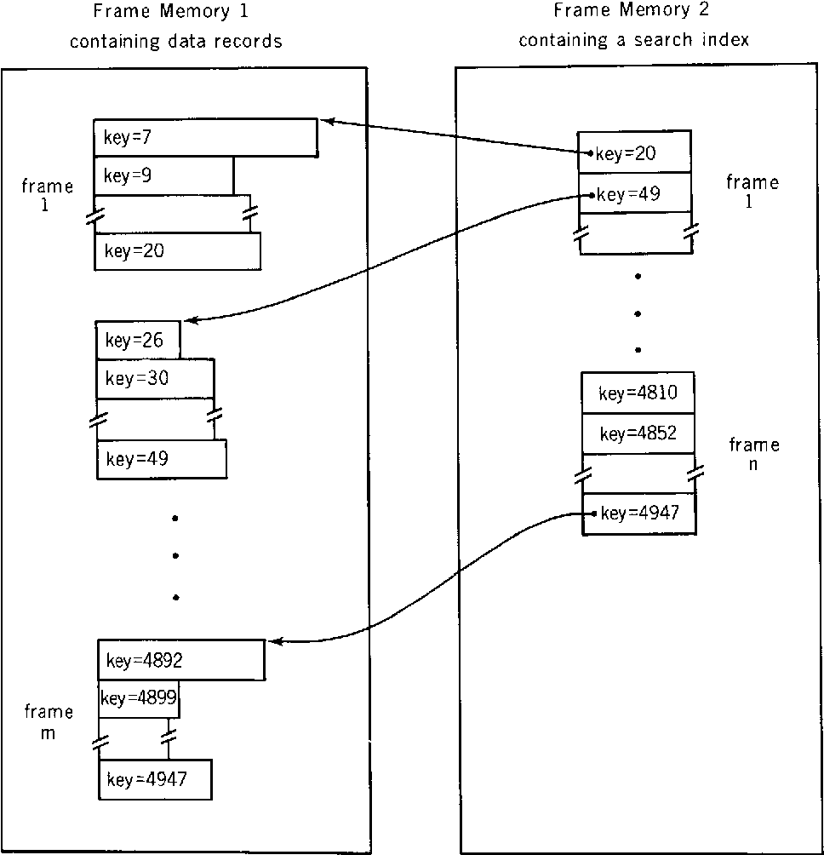
Types of Data Models
PHYSICAL DATA MODELS
FRAME MEMORY MODEL
“Frame memory is a virtual view of secondary storage that can be implemented with reasonable overhead to support database record storage and accessing requirements.”
2

Slide 42
DBMS Languages (cont.)
Provides users with
Data definition language (DDL)
Data manipulation language (DML)
Data control language (DCL)
Transaction Control Language (TCL)
Often these are all the same language

Slide 43
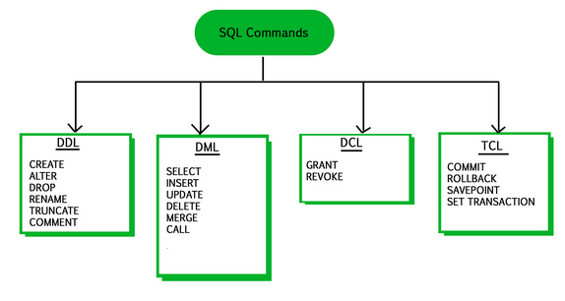
DBMS Languages (cont.)

Slide 44
DBMS Languages (cont.)
These SQL commands are mainly categorized into four categories as discussed below:
DDL(Data Definition Language) : DDL or Data Definition Language actually consists of the SQL commands that can be used to define the database schema. It simply deals with descriptions of the database schema and is used to create and modify the structure of database objects in database. Examples of DDL commands:
CREATE – is used to create the database or its objects
DROP – is used to delete objects from the database.
ALTER-is used to alter the structure of the database.
TRUNCATE–is used to remove all records from a table, including all spaces allocated for the records are removed.
COMMENT –is used to add comments to the data dictionary.
RENAME –is used to rename an object existing in the database.

Slide 45
DBMS Languages (cont.)
DML(Data Manipulation Language) : The SQL commands that deals with the manipulation of data present in database belong to DML or Data Manipulation Language and this includes most of the SQL statements. Examples of DML:
SELECT – is used to retrieve data from the a database.
INSERT – is used to insert data into a table.
UPDATE – is used to update existing data within a table.
DELETE – is used to delete records from a database table.

Slide 46
DBMS Languages (cont.)
DCL(Data Control Language) : DCL includes commands such as GRANT and REVOKE which mainly deals with the rights, permissions and other controls of the database system. Examples of DCL commands:
GRANT-gives user’s access privileges to database.
REVOKE-withdraw user’s access privileges given by using the GRANT command.
TCL(Transaction Control Language) : TCL commands deals with the transaction within the database. Examples of TCL commands:
COMMIT– commits a Transaction.
ROLLBACK– rollbacks a transaction in case of any error occurs.

Slide 47

Any Questions??

